Slide 1
Liv-Lyf
A Disease Management Web Application

Slide 2

Motivation
To solve the problem people face when they are in search of hospital beds, vaccines, or while visiting some place having concern of number of cases in that area.
Building a project to help Society and ease life of people.

Slide 3

Our Progress Till Now
Built Liv-Lyf Database

Slide 4
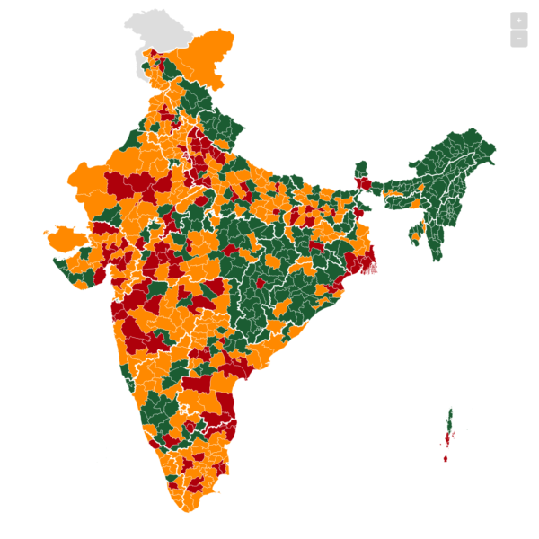
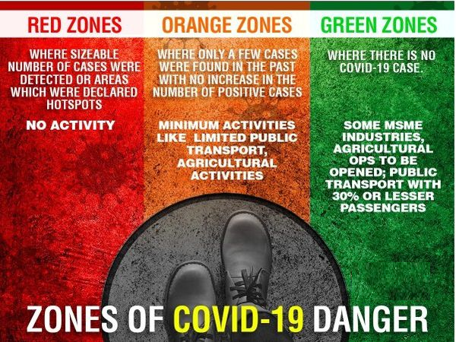

Our Liv-Lyf Database
Is helpful in finding RED ZONE, ORANGE ZONE, GREEN ZONE places by looking at COVID POSITIVE Patient in a given region.
Is CAPABLE OF SHOWING LIVE-VACCINATION STATUS

Slide 5
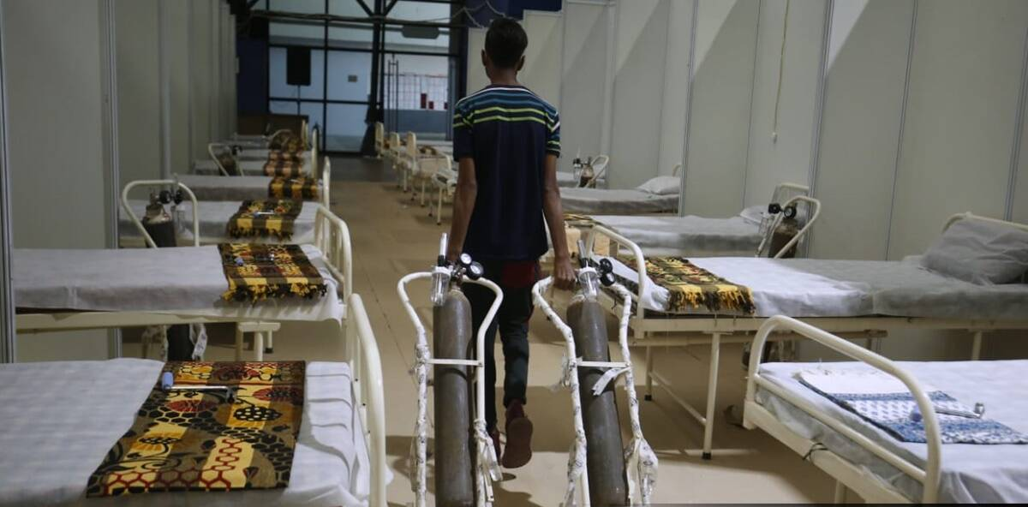

Liv-Lyf Database
Is providing true live-status of available beds and oxygen-cylinder locality-wise/ hospital-wise/city-wise.
Is empowering India by providing honest and transparent status of hospital and vaccination center on the fingertips of every-person

Slide 6
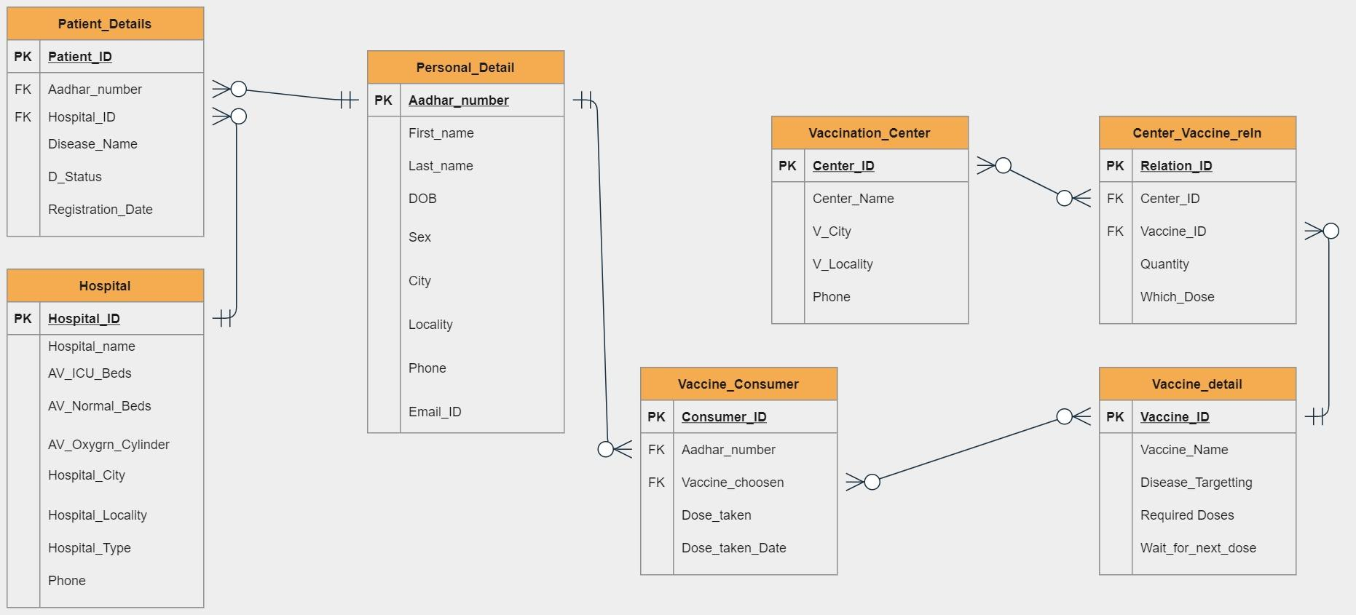
ER Diagram of Liv-Lyf Database

Slide 7
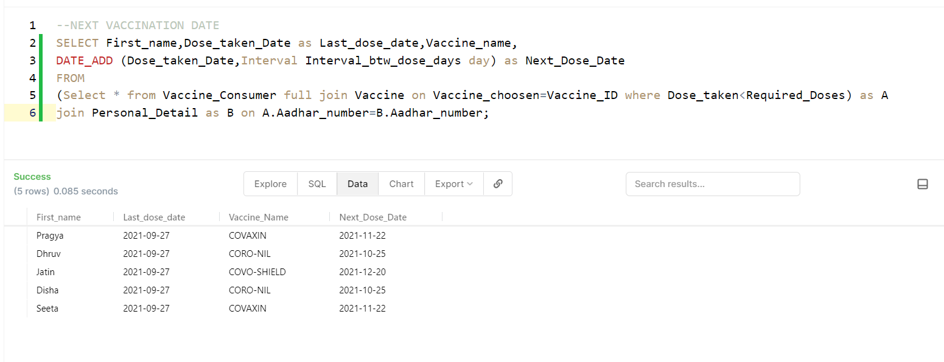
Queries

Slide 8
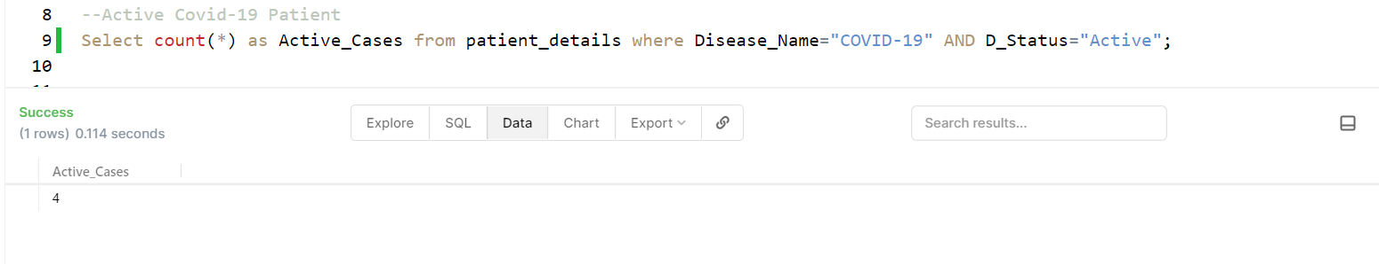
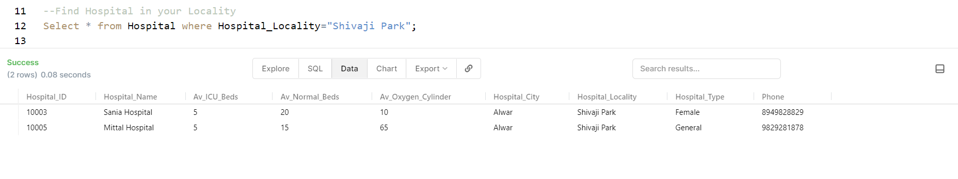
Queries

Slide 9
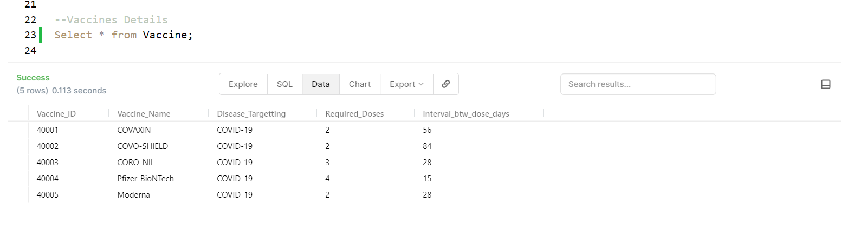
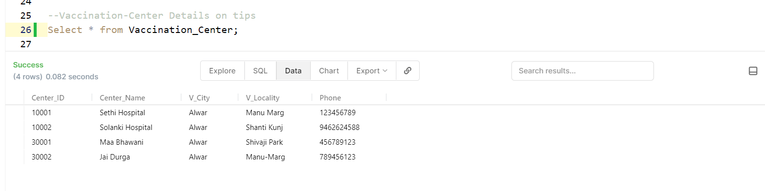
Queries

Slide 10
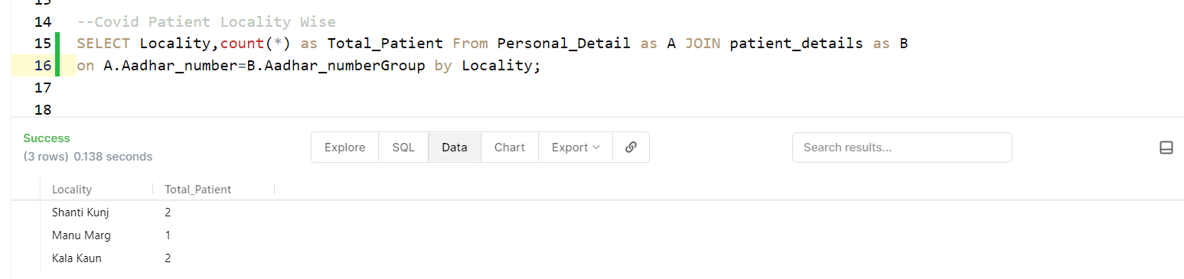
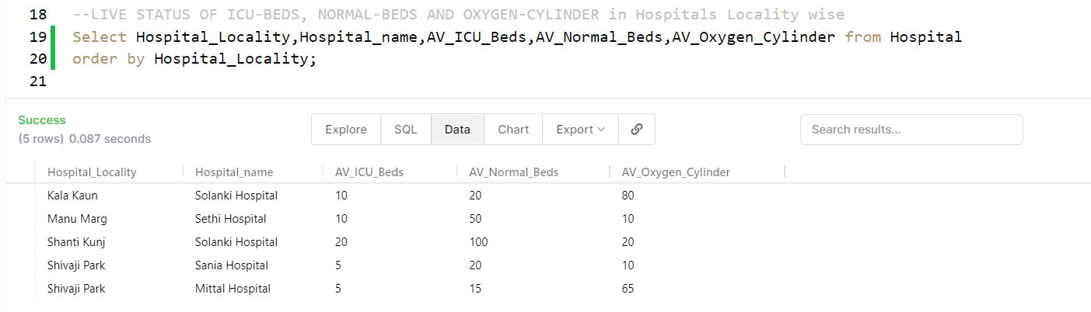
Queries

Slide 11

And More to Come...

Slide 12
Thank You
For Your Attention...
Liv-Lyf Project by-
Aditya Kumar Rai (20075100)
Gaurav Kumawat (20075033)

